Slide 1

Getting started…
Please sit in rows A through J only
Form a group with 3-5 students and sit with your group
Learn each others’ names
Thanks!
Ask For Me!
bit.ly/100Aclass

Slide 2
Today
Overview of explanatory models
Two-group model – specifying
Fitting, predict, resid (partitioning scores)
Comparing to empty model

Slide 3
Adding an Explanatory Variable to the Model
Psych 100A Fall 2018
Prof. Jim Stigler

Slide 4
Overview of Where We Are Going

Slide 5
The Practice of Data Analysis
Explore Variation
Model Variation
Evaluate Models
Measurement
Sampling
Design
data
Tell Your Story
Make Predictions
Notes:
Statistics is the study of variation.
We use variation in data to represent variation in world; try to find out about the DGP.

Slide 6
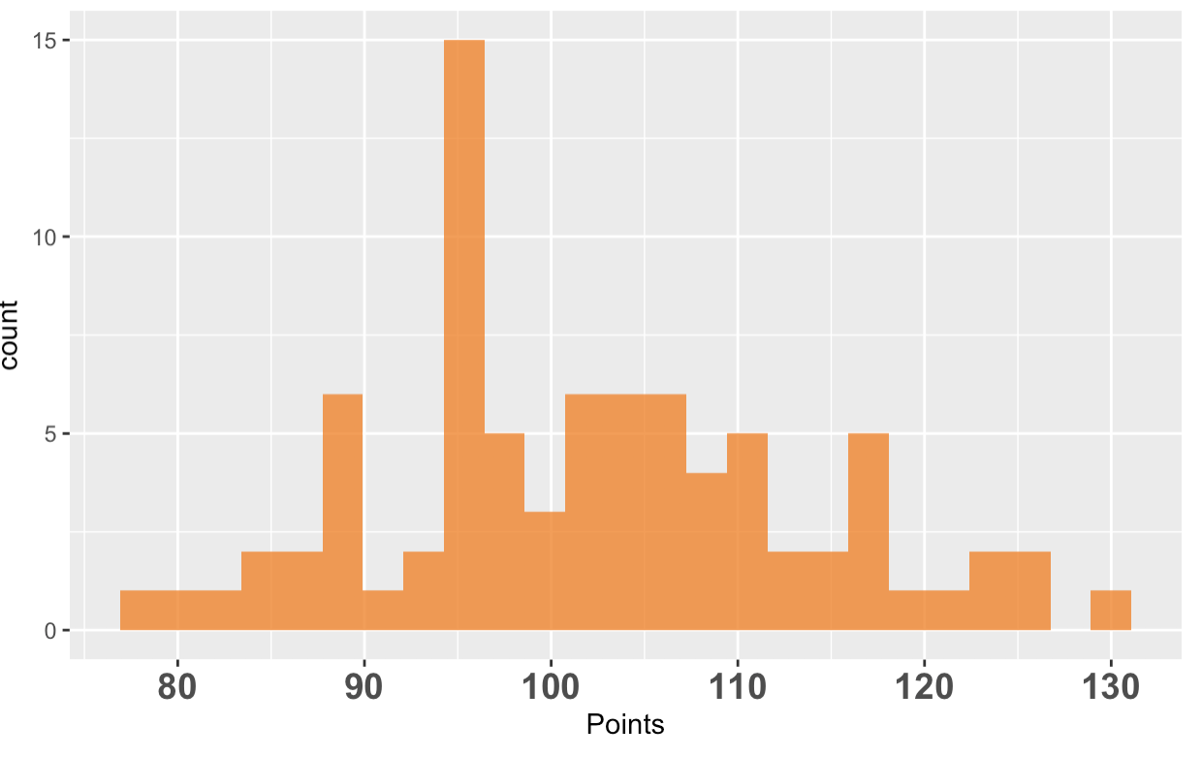
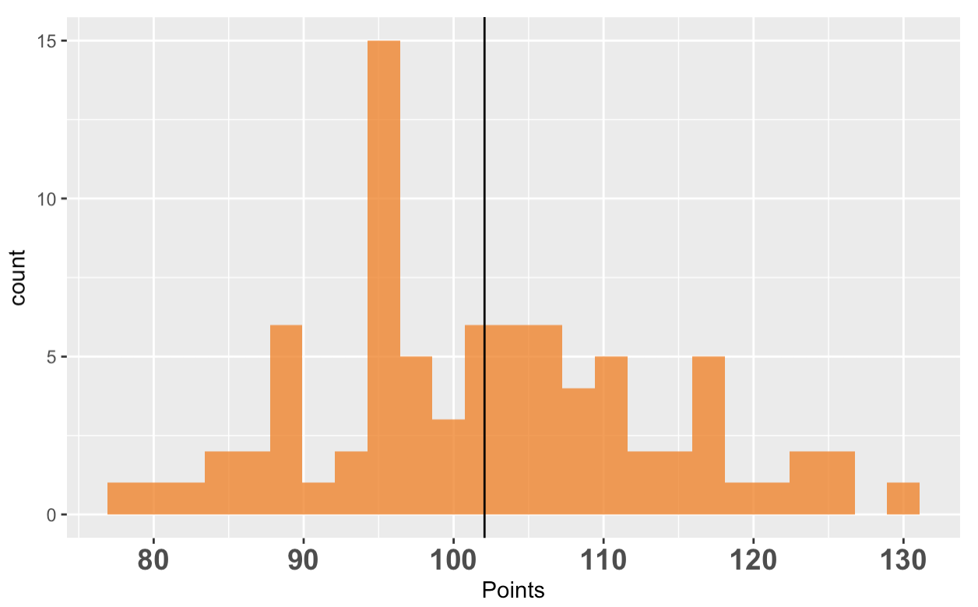
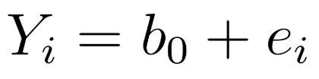

Empty Model Gives Birth to Error
Where, exactly, does the empty model minimize error?
SS tells us how much total error
Notes:
Get the students to gesture.

Slide 7
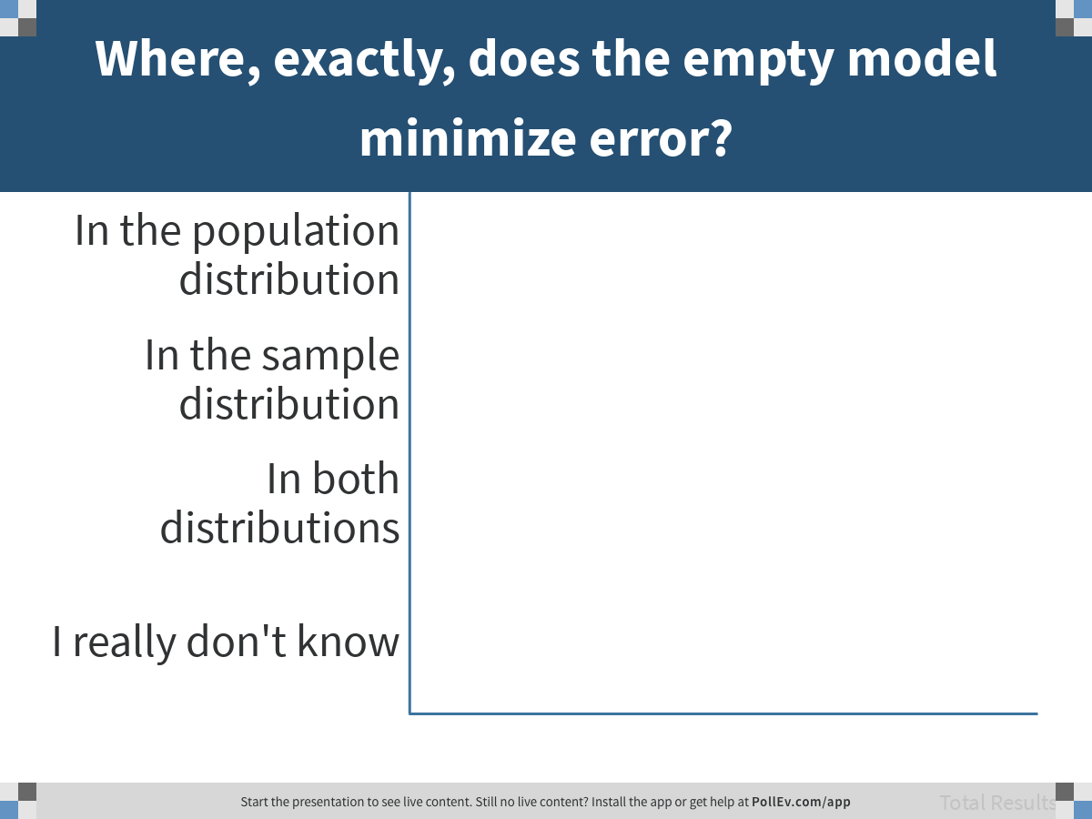
Notes:
Where, exactly, does the empty model minimize error?
https://www.polleverywhere.com/multiple_choice_polls/NoP0uAdWglqs3E95q47CD

Slide 8
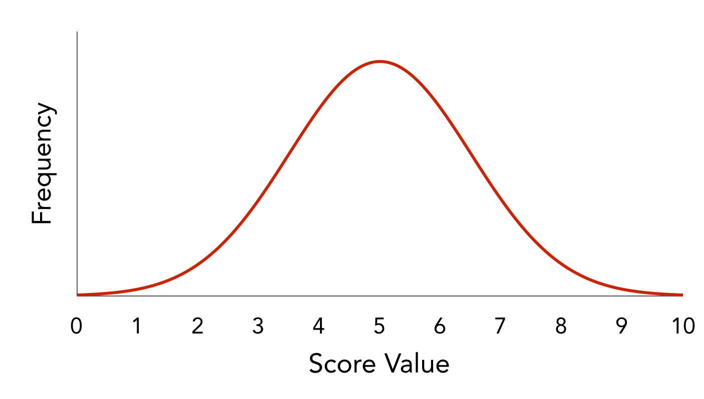
Core Concepts: Models & Distribution Triad
Hidden
Models
data = model + error
Population/
DGP)
Real
Imaginary
Sampling Distribution
Sample
Distribution

Slide 9
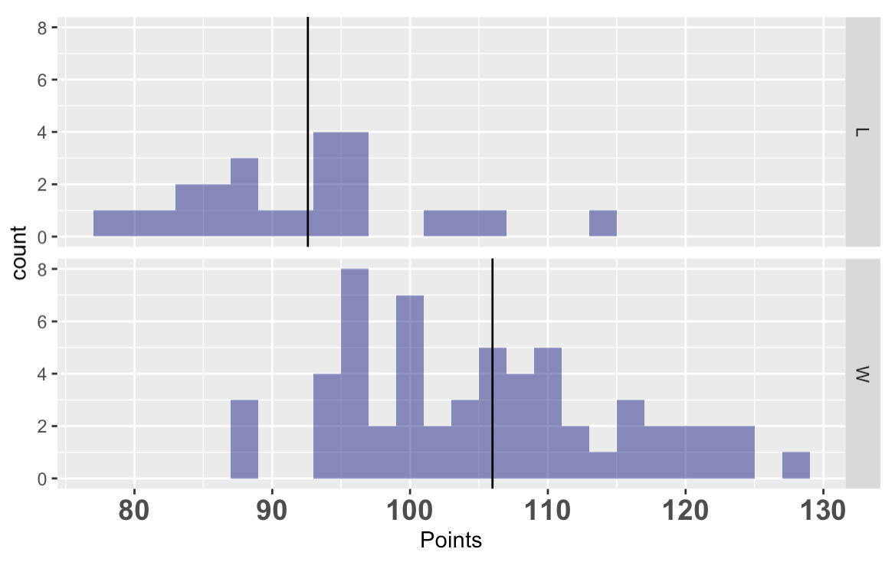
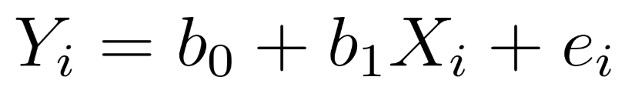
Explanatory Models Seek to Reduce Error
empty
two-group
DATA = MODEL + ERROR
Notes:
Get the students to gesture.

Slide 10
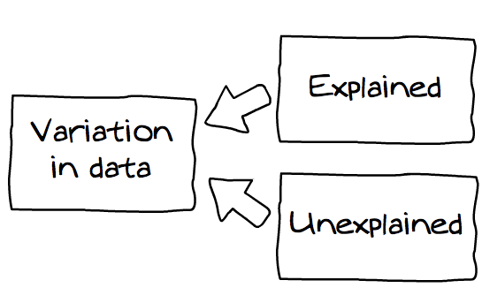
How should we interpret sum of squares from the empty model?
DATA = MODEL + ERROR
measured
unmeasured
Notes:
So far we have explored variation, and created our empty model.
Empty model gives us best predictor.
Quantifying error around empty model does not explain variation, but tells us how much total there is to explain.

Slide 11
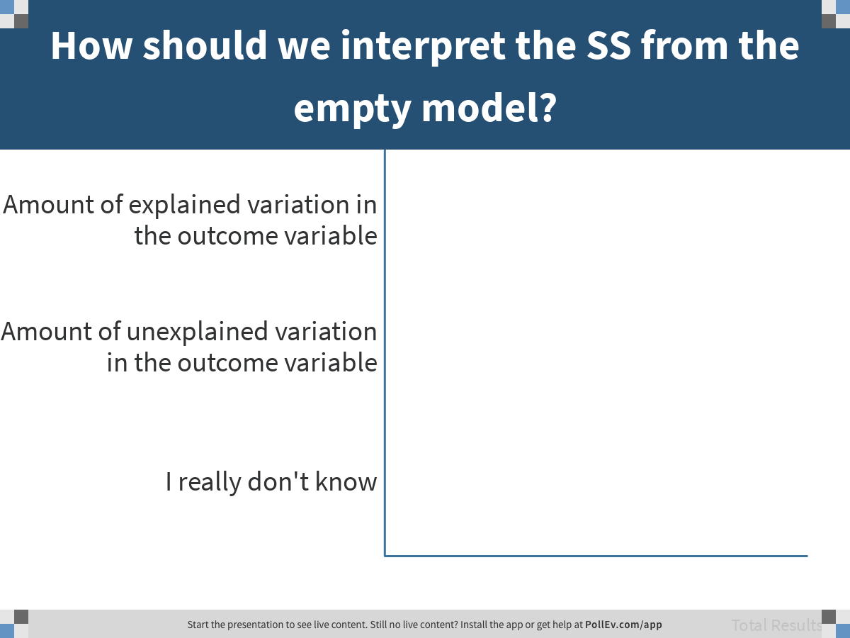
Notes:
How should we interpret the SS from the empty model?
https://www.polleverywhere.com/multiple_choice_polls/hC26DV14MWkZPbEzfACzT

Slide 12
SS from Empty Model Quantifies Total Error
DATA = MODEL + ERROR
SS Total
Empty
Model
Total
Variation in Outcome

Slide 13
Complex Models Explain Error
DATA = MODEL + ERROR
Explained
Variation
Unexplained
Variation
SS Model
SS Error
Group
Model
SS Total
Empty
Model
Total
Variation in Outcome
Total Variation = Explained Variation + Unexplained Variation

Slide 14
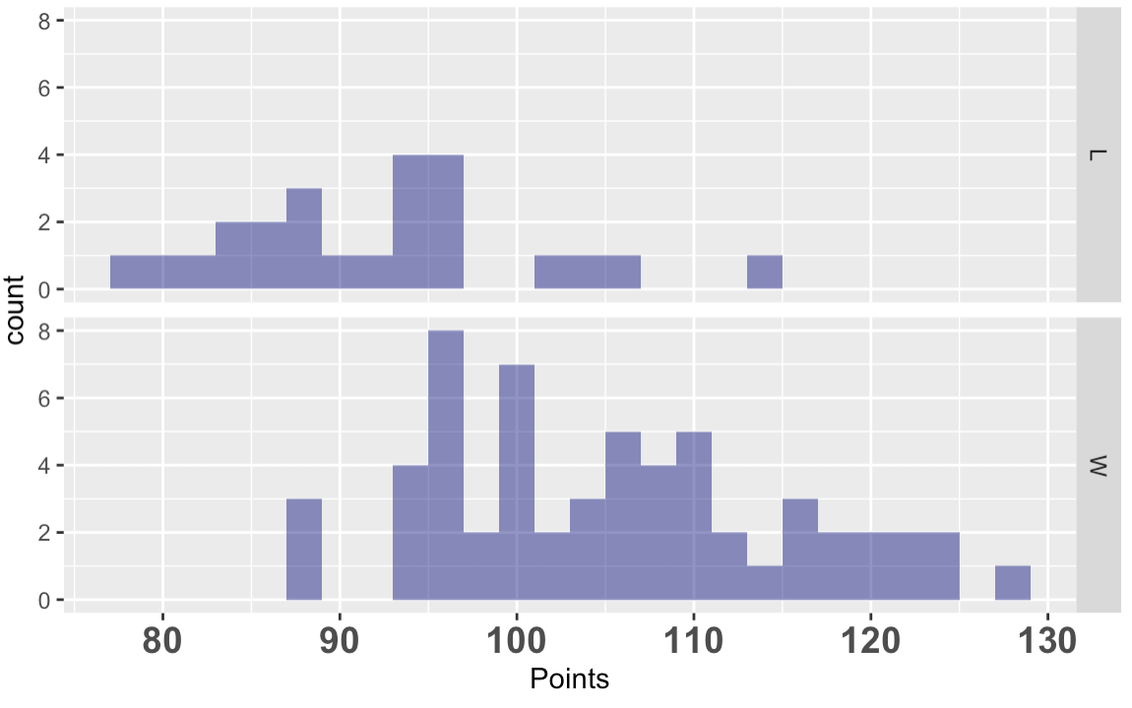
What it means to “explain”
From intuitive idea…
to quantitative one…

Slide 15
Error in the Two-Group Model
DATA =
MODEL + ERROR
Total error is unchanged
Reducing unexplained error increases explained error
SS Model
(explained)
SS Error (unexplained)
SS Total

Slide 16
Explaining Error as Model Comparison
DATA = GROUP + ERROR
SS Model
SS Error
Group
Model
SS Total
Empty
Model
DATA = MEAN + ERROR
How much is error reduced in the GROUP model vs. the EMPTY model?

Slide 17
Explaining Error as Model Comparison
Error Reduced
DATA = GROUP + ERROR
SS Model
SS Error
Group
Model
SS Total
Empty
Model
DATA = MEAN + ERROR
How much is error reduced in the GROUP model vs. the EMPTY model?

Slide 18
Explaining Error as Model Comparison
SS Model
SS Error
Group
Model
SS Total
Empty
Model
Empty model let us partition each score into model (mean) + error. Explanatory models let us reduce error. Now we can partition each score into error from the model, and error reduced from the empty model.

Slide 19
Digging into the Details

Slide 20
Digging into the details
Specifying the two-group model
Fitting the model
Partitioning error in scores
Partitioning aggregate error
Sum of Squares
PRE
Let’s do this with a new data set…

Slide 21
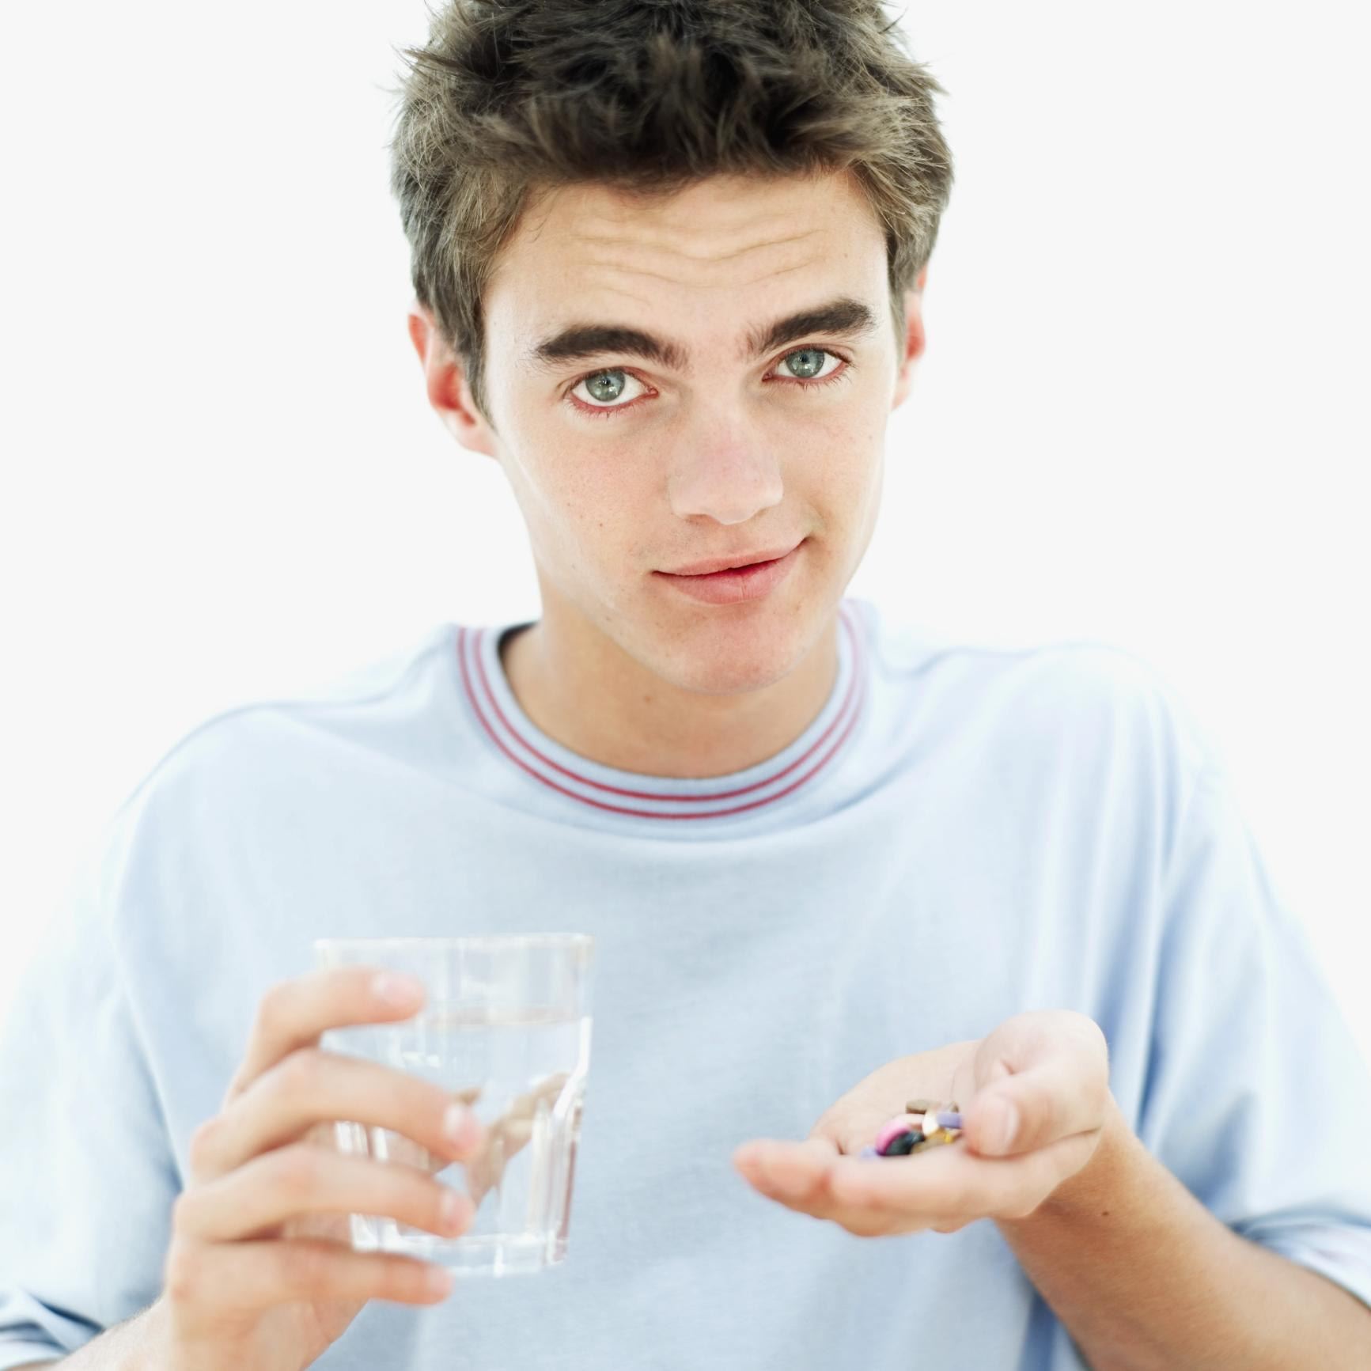
Can Respect Improve Medical Adherence?
Hypothesis: Respectful instructions will create better medical adherence
(especially in adolescents)
David S. Yeager, Quinn Hirschi, and Robert A. Josephs

Slide 22
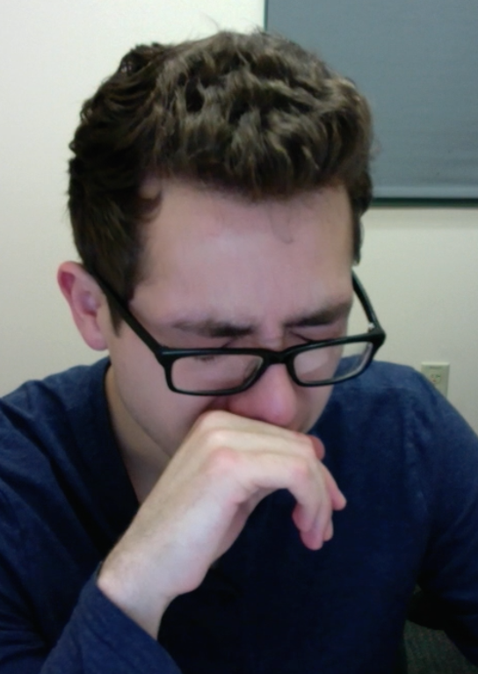
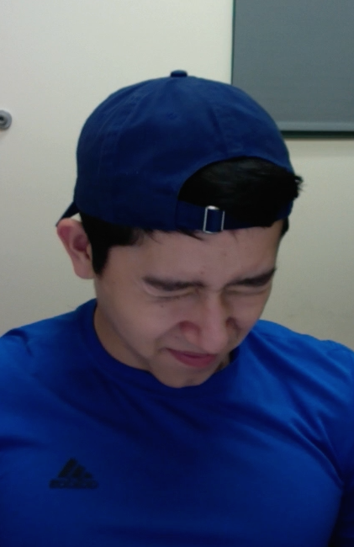
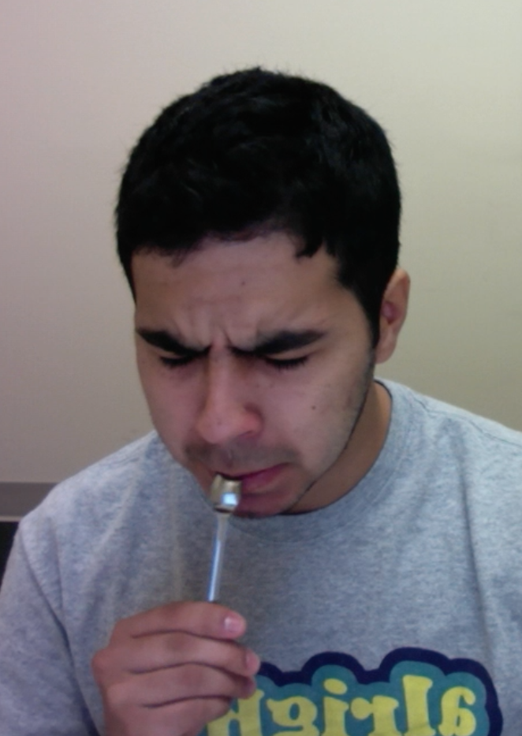
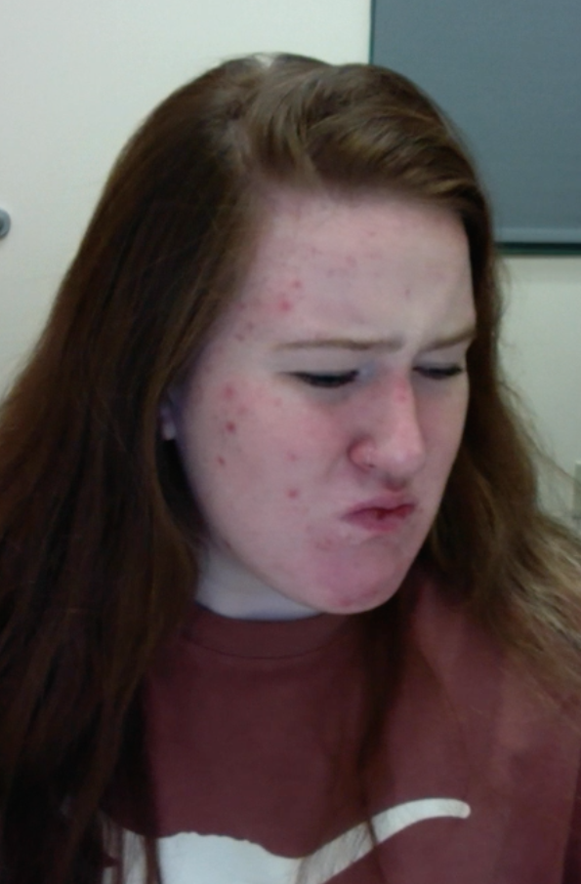
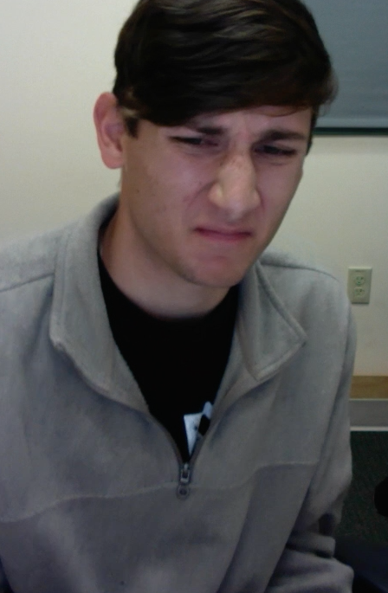
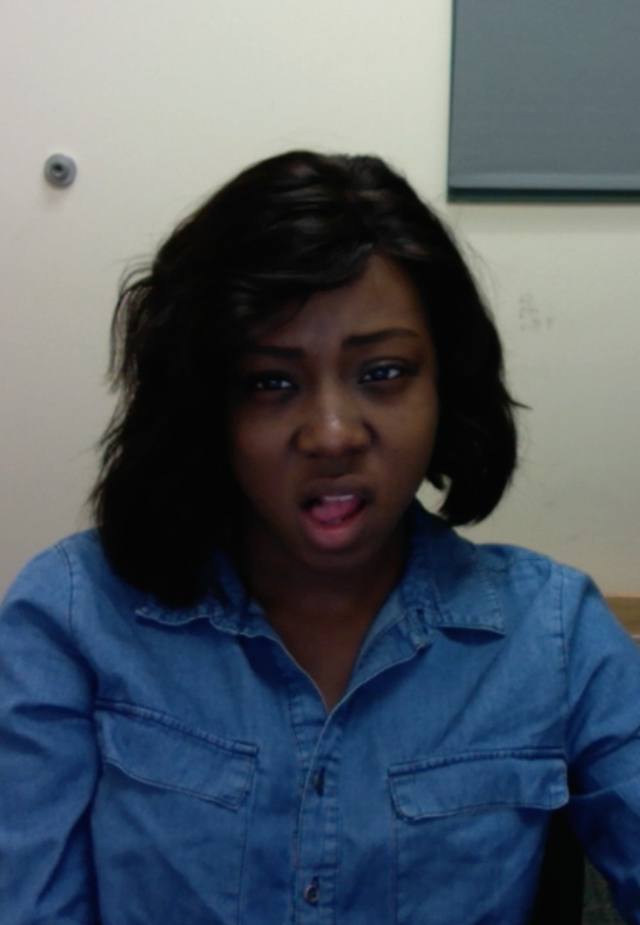
Notes:
And as you can see here, our participants successfully recreated the YouTube video you saw earlier…
We think these images add to the quantitative data in showing that taking the Vegemite was not a behavior participants found pleasant or that they were intrinsically motivated to do.

Slide 23
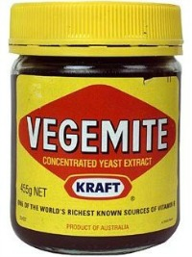
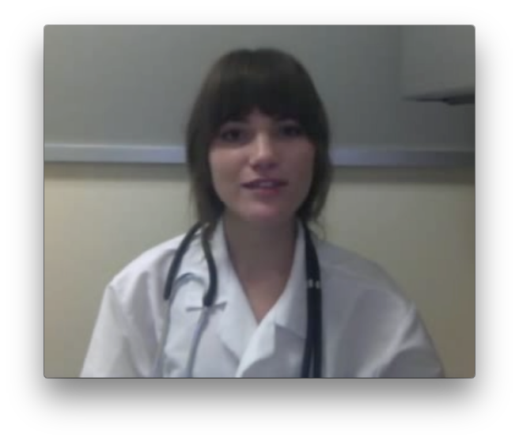
Study Procedure
0.1 g
0.4 g
Taste medicine
(spoon1)
Watch video instructions
(Respectful or Not)
How much medicine did they eat? (spoon2)
Notes:
**
As soon as participants arrived in our lab, we had them sample 0.1 gram of the Vegemite.
We wanted them to see how it tasted before beginning our experiment, and as you might have predicted, they rated it as overwhelmingly bitter and unpleasant to take.
Then, we told participants they would be participating in two separate studies that had been bundled together for the sake of time.
**
In the first study, the researchers would be measuring the effects of testosterone administration on individual attitudes and preferences.
Under the guise of this study,
We collected a baseline salivary hormone sample.
Then we had participants self administer a nasal spray that contained 14 milligrams of either testosterone or a placebo control (participants and experimenters were both blind to drug condition, and were kept blind to drug condition throughout the experiment).
As we started waiting for the drug to absorb in their system, we had participants complete a few questionnaires.
**
After participants completed the questionnaires, we told them they would be beginning the second study. In this study, they believed we were helping the medical school develop a new protocol to evaluate medical students.
First, participants read medical magazines to “familiarize themselves with the medical field.” In reality, they were completing an innocuous tasks while we waited exactly 45 minutes for the drug to absorb in their system.
At exactly 45 minutes, participants were randomly assigned (via a Qualtrics survey) to receive status-enhancing or status-diminishing video instructions from a medical student to take another spoonful of .4 gram of the Vegemite, which was on the table in front of them.
Immediately after receiving these instructions, participants made a real choice about whether or not to take the spoonful of Vegemite, and then they reported how respected, autonomous, competent, and high status the medical student giving them the instructions made them feel.
We assessed these feelings with 8 items – 2 items for each construct. For example, one of the items to measure respect was “The person in the video made me feel respected.”

Slide 24
Video Instructions (2 Versions)
STATUS-ENHANCING STATUS-DIMINISHING
(autonomy/competence supportive) (autonomy/competence threatening)
Hello. My name is … and I'm a second year medical student finishing basic sciences at one of the UT system medical branches. I’m here to…
Ask whether you might consider taking this medicine.
Tell you that you should take this medicine.
You are a UT student, so I figured I would explain the scientific reason why it would be helpful for you to take it.
Based on what I know about medicine and disease, the smart thing to do is to take this medicine.
Some people have reported that this medicine is unpleasant to take because of the bitter taste…
You might find it helpful to think of that slight discomfort as doing your part to help others.
Try to ignore that.
Thank you for considering this request.
Thank you in advance for your cooperation.
(Maslow, 1943; Vansteenkiste, Lens, & Deci, 2006)
Notes:
The status-enhancing instructions were meant to convey *respect* – using insights from self-determination theory to honor participants’ autonomy, competence, and potential to contribute to the world beyond the self.
The status-diminishing instructions were meant to convey *disrespect* by compromising participants’ autonomy, competence, and potential to contribute.
In the enhancing condition, the medical student appealed to participants' high status as a student at an elite university,
Whereas in the diminishing condition, participants were made to feel like a mere undergraduate in comparison to a much more high status and elite medical student.
Further, in the enhancing condition, participants were provided with a reasonable rationale for why they might choose to take the medicine,
Whereas in the diminishing condition, they received no further explanation than, "I am the authority figure, I know what's best, and you should do this because this is what I'm telling you to do."
Immediately after receiving the instructions, participants made a real decision about whether or not to take spoonful of Vegemite.

Slide 25
Look at Data Frame Vegemite.brief

Slide 26
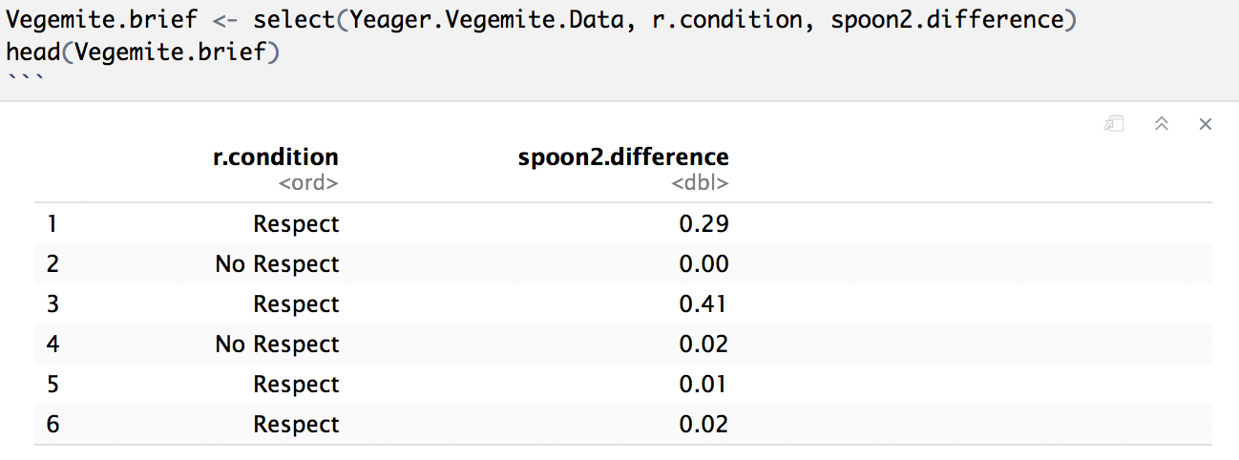
Vegemite.brief
What would a value of 0 on the outcome variable mean?

Slide 27
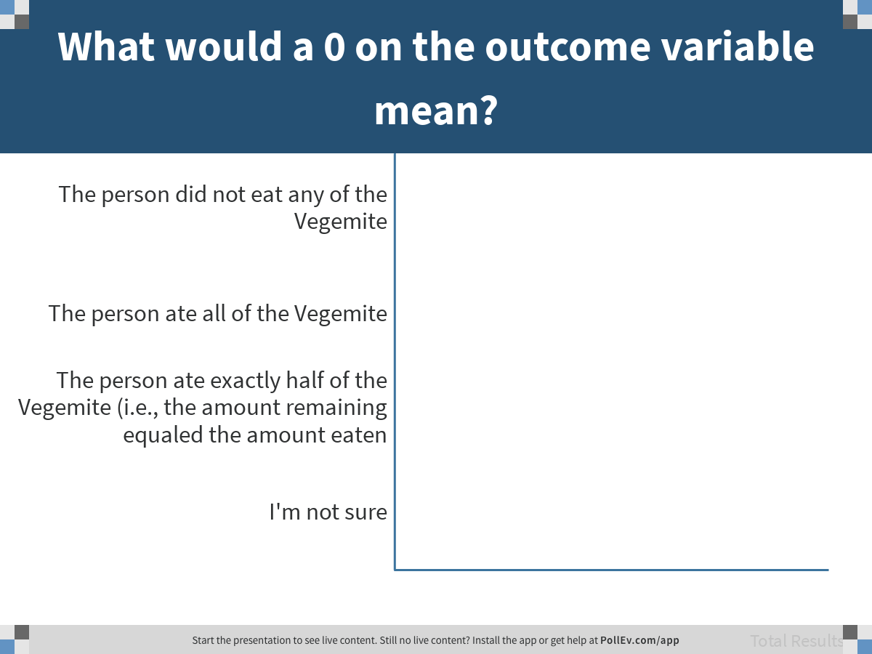
Notes:
What would a 0 on the outcome variable mean?
https://www.polleverywhere.com/multiple_choice_polls/wV4YCxXKPrYw4ZUvhhL4t

Slide 28
Explore the distribution of the outcome variable.

Slide 29
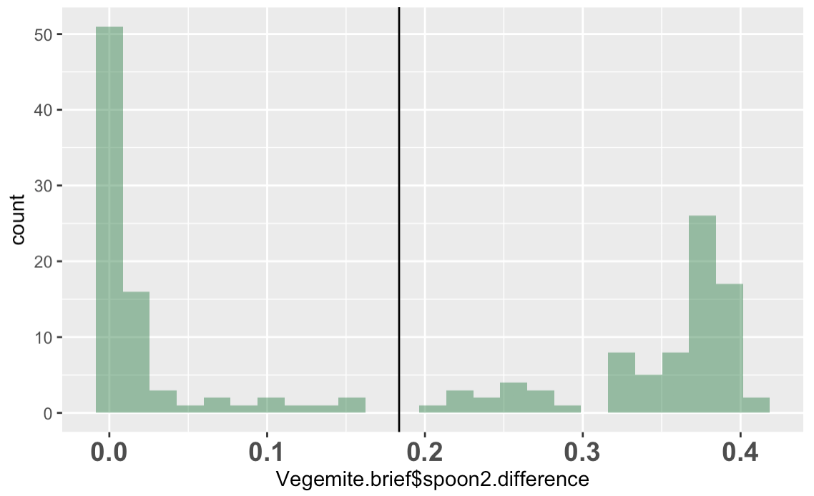
Is the mean a good model of spoon2.difference?

Slide 30
Is the mean a good model of spoon2.difference?
Does the mean minimize SS in the distribution of spoon2.difference?

Slide 31
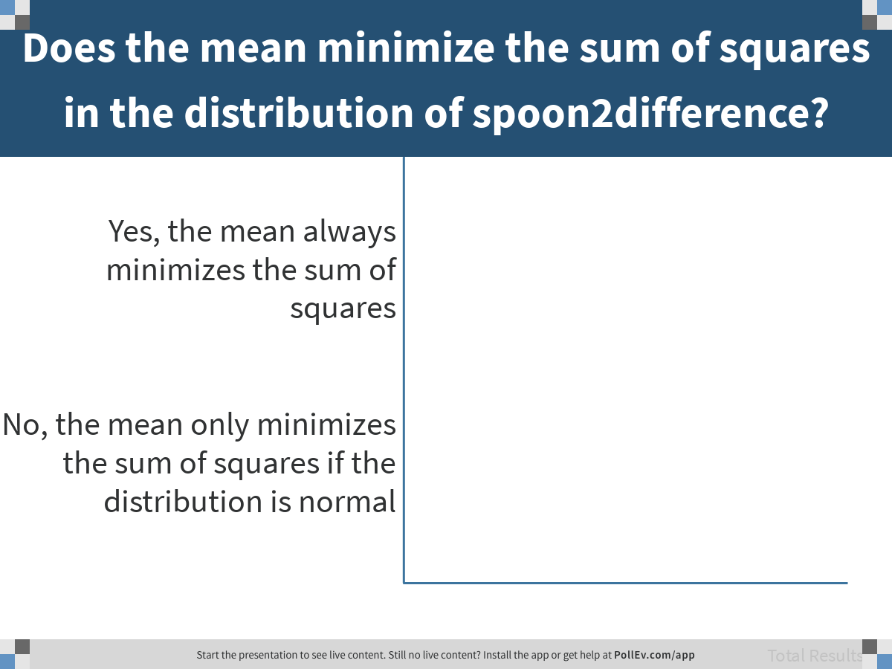
Notes:
Does the mean minimize the sum of squares in the distribution of spoon2difference?
https://www.polleverywhere.com/multiple_choice_polls/JCxQ68tPwZGXBgt8wKPgY

Slide 32
Explore visually: do you think respect.condition explains variation in spoon2.difference?

Slide 33
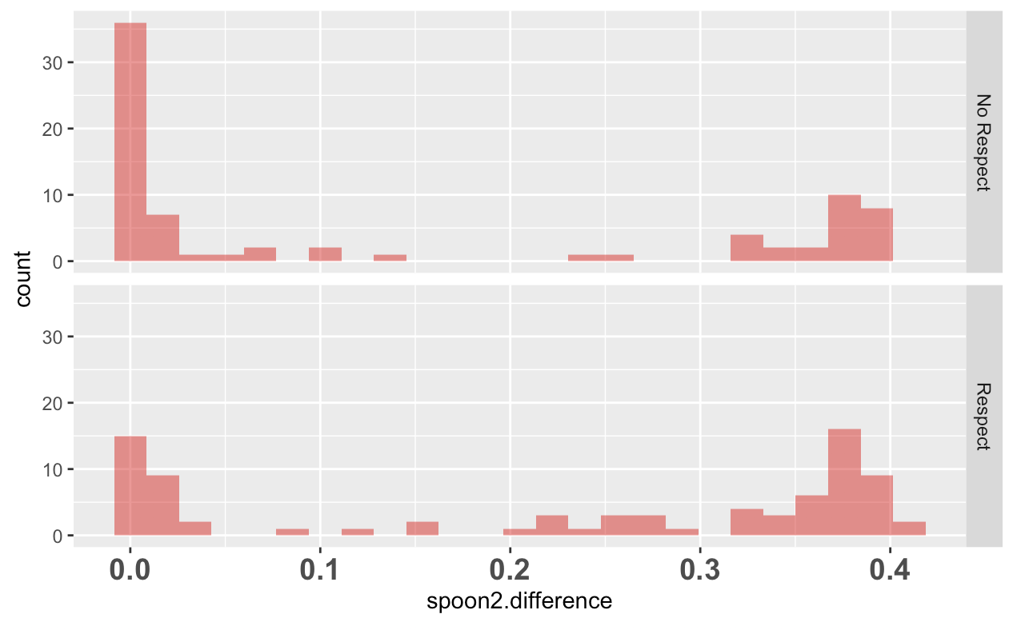
spoon2.difference by Respect
Did respect make a difference?

Slide 34
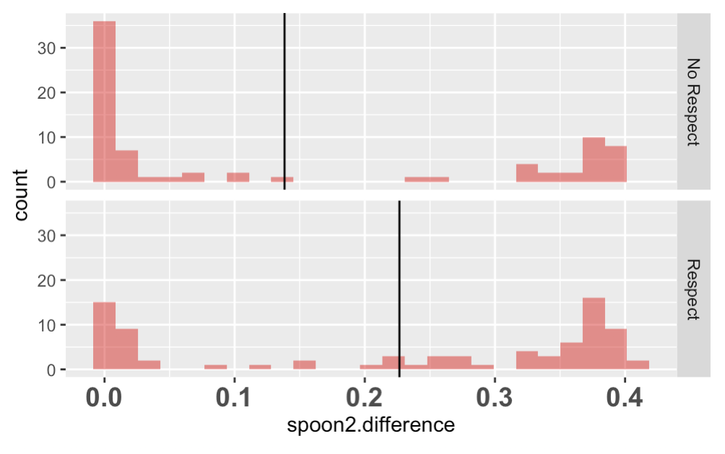
spoon2.difference by Respect
What are the possible causes of this mean difference? (discuss)
Notes:
Make sure random sampling variation is one!

